Slide 1
Parallelizing the Interpolation between Latent Space of Autoencoder Networks
Tansin Jahan
School of Computer Science
Carleton University, Ottawa, Canada
tansinjahan@cmail.carleton.ca

Slide 2
Overview
Related work
Project overview
Convolutional Neural Network
Algorithm
Parallelism
CUDA parallel programming framework
Introduction to Numba
Experiment
Analysis of results
Limitation and Challenges
Questions

Slide 3
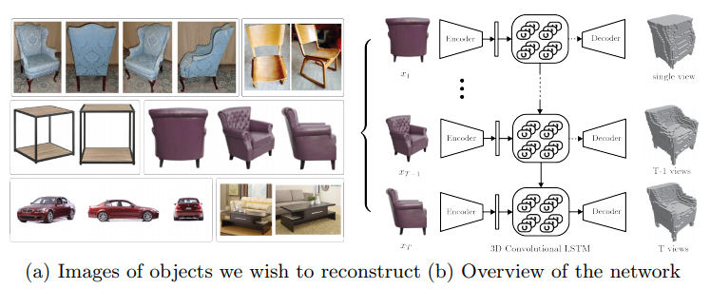
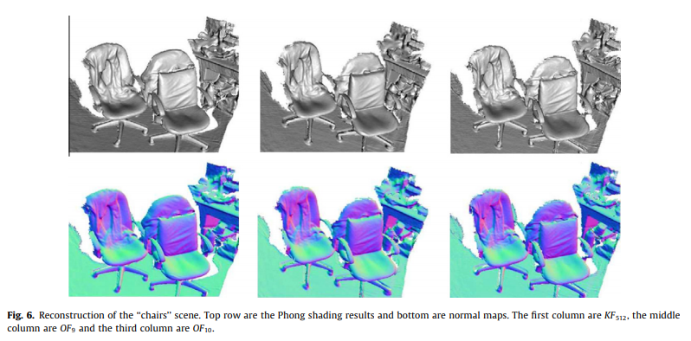
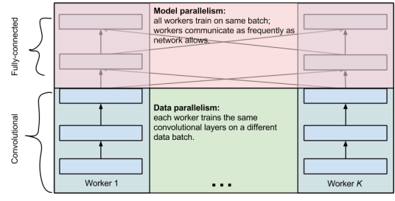
Related Work
3D-R2N2: A Unified Approach for Single and Multi-view 3D Object Reconstruction (2016)
[Christopher B. Choy, Danfei Xu, JunYoung Gwak, Kevin Chen, Silvio Savarese]
Octree-based fusion for realtime 3D reconstruction (2012)
[Ming Zeng, Fukai Zhao, Jiaxiang Zheng, Xinguo Liu]
One weird trick for parallelizing convolutional neural networks (2014)
[Alex Krizhevsky]

Slide 4
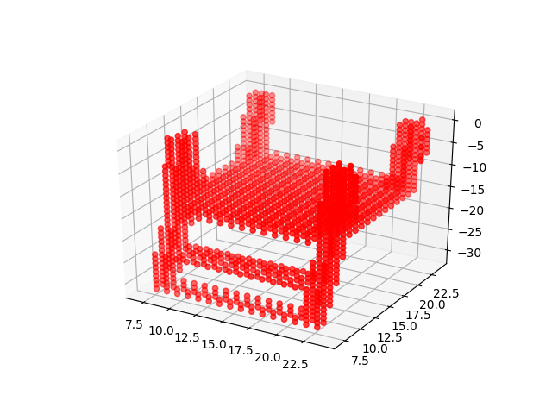
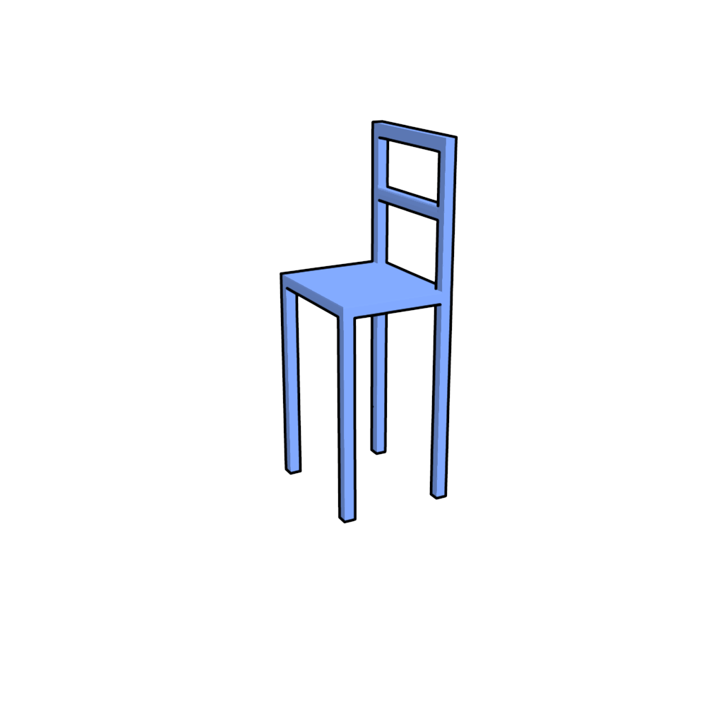
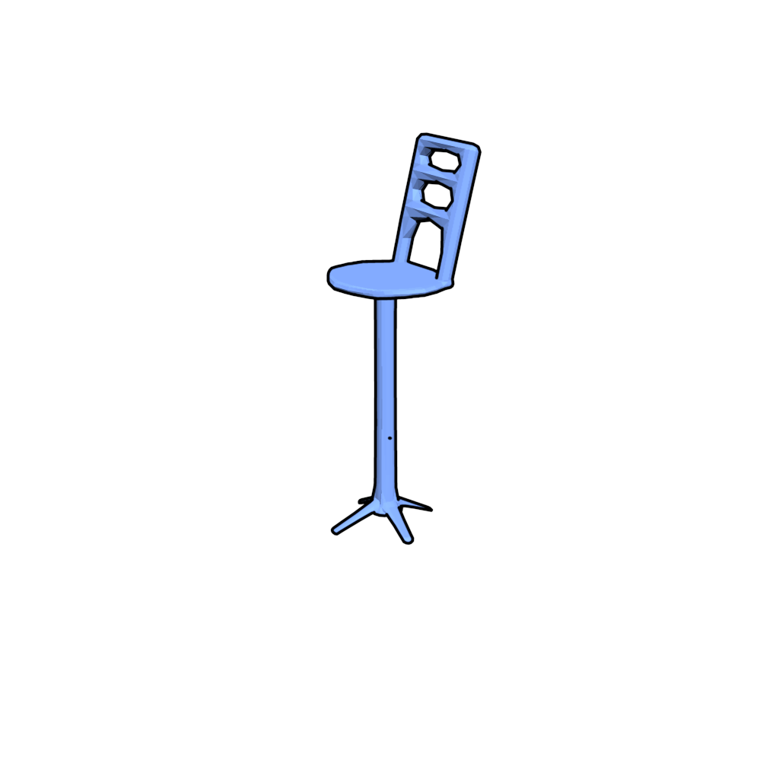
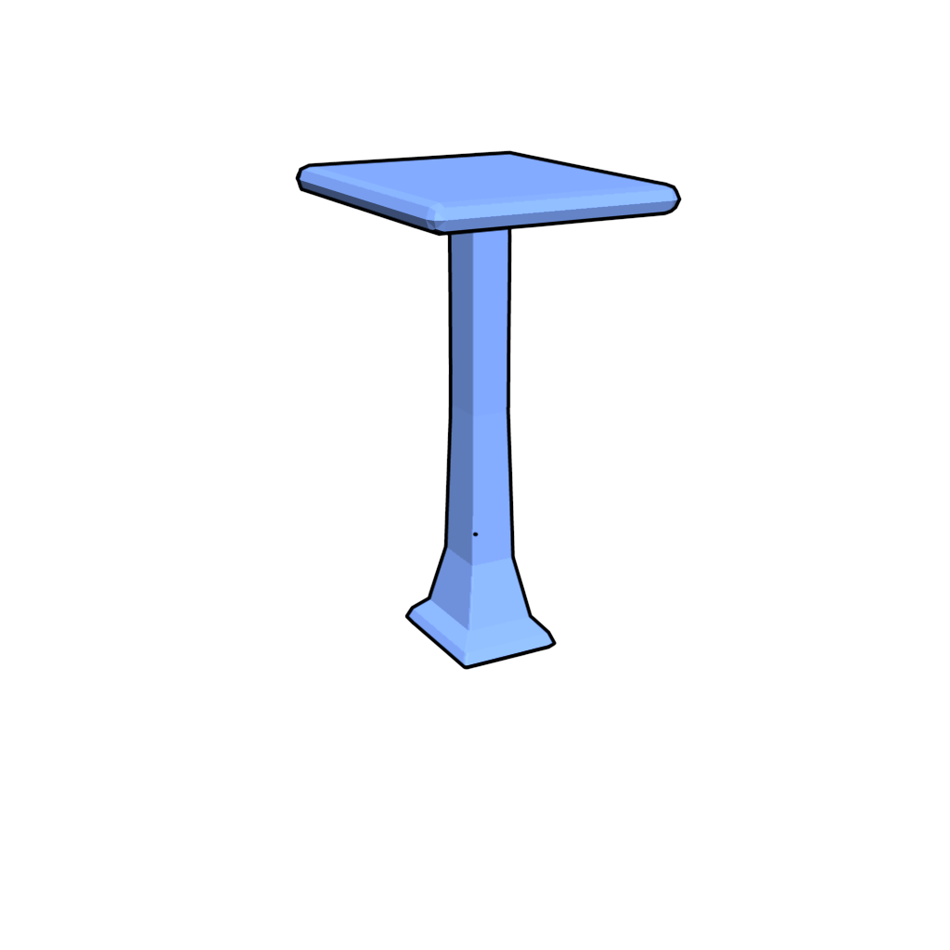
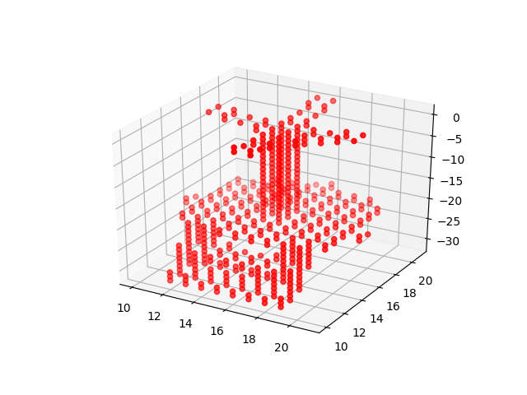
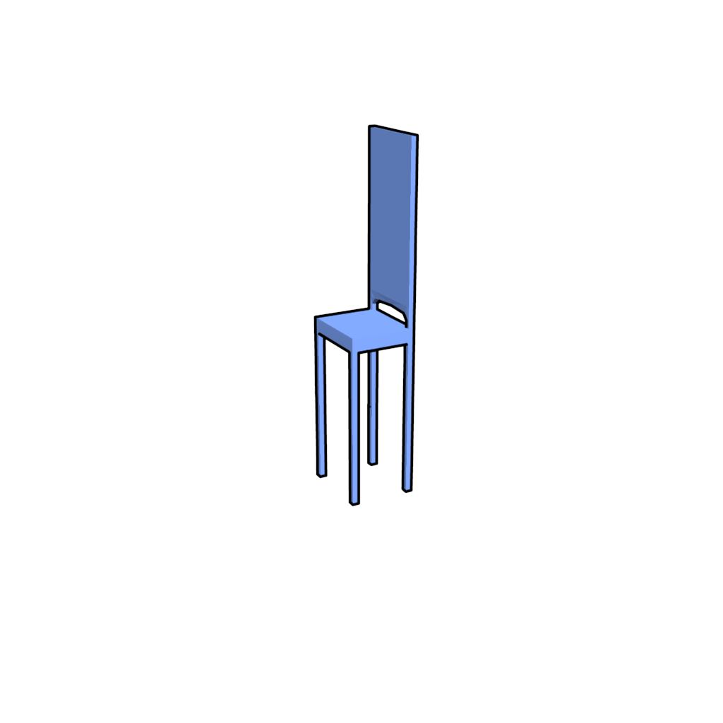
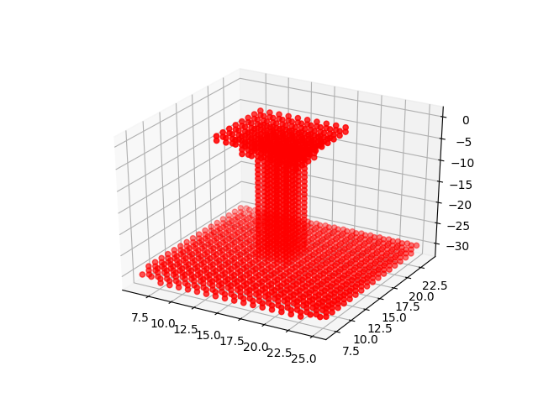
Project Overview
Autoencoder
Converted 3D voxelized shape
Deep Network
Reconstructed output
Actual chair models

Slide 5
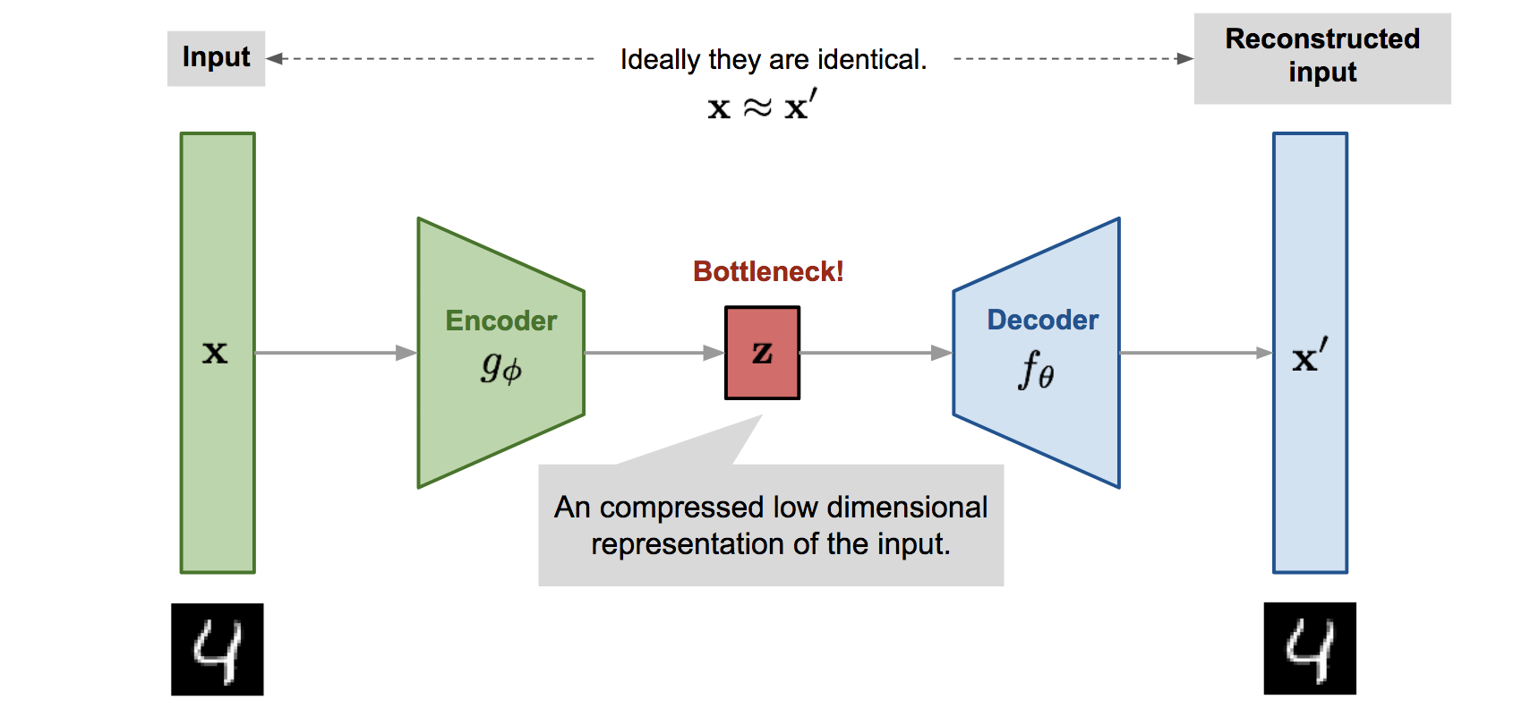
Autoencoder
3 Convolutional layer
3 Deconvolutional layer

Slide 6
Autoencoder
def autoencoder(inputs): # encoder # 32 x 32 x 32 x 1 -> 16 x 16 x 16 x 32 # 16 x 16 x 16 x 32 -> 8 x 8 x 8 x 16 # 8 x 8 x 8 x 16 -> 2 x 2 x 2 x 8 net = lays.conv3d(inputs, 32, [5, 5, 5], stride=2, padding='SAME') net = lays.conv3d(net, 16, [5, 5, 5], stride=2, padding='SAME') net = lays.conv3d(net, 8, [5, 5, 5], stride=4, padding='SAME') latent_space = net
# decoder # 2 x 2 x 2 x 8 -> 8 x 8 x 8 x 16 # 8 x 8 x 8 x 16 -> 16 x 16 x 16 x 32 # 16 x 16 x 16 x 32 -> 32 x 32 x 32 x 1 net = lays.conv3d_transpose(net, 16, [5, 5, 5], stride=4, padding='SAME') net = lays.conv3d_transpose(net, 32, [5, 5, 5], stride=2, padding='SAME') net = lays.conv3d_transpose(net, 1, [5, 5, 5], stride=2, padding='SAME', activation_fn=tf.nn.tanh)
return latent_space, net

Slide 7
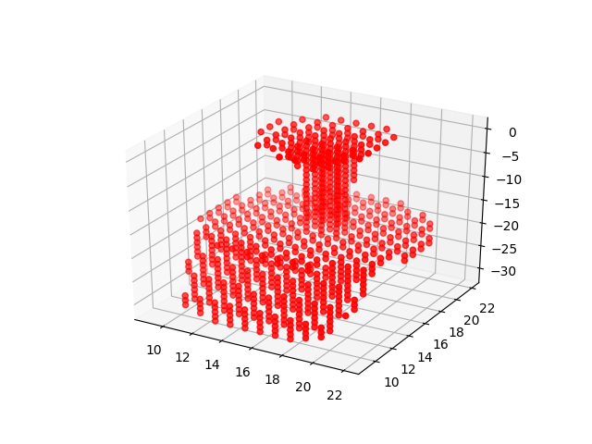
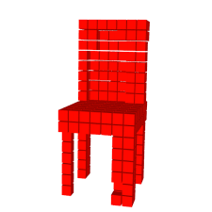
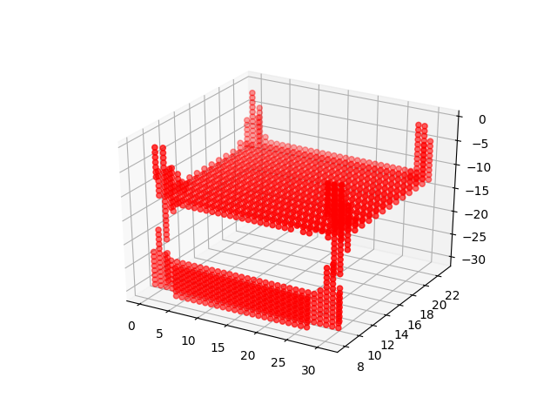
Interpolation in latent space
New_Z
Z1
Encoder
Decoder
Z2
New shape of the Object
Parallelization

Slide 8
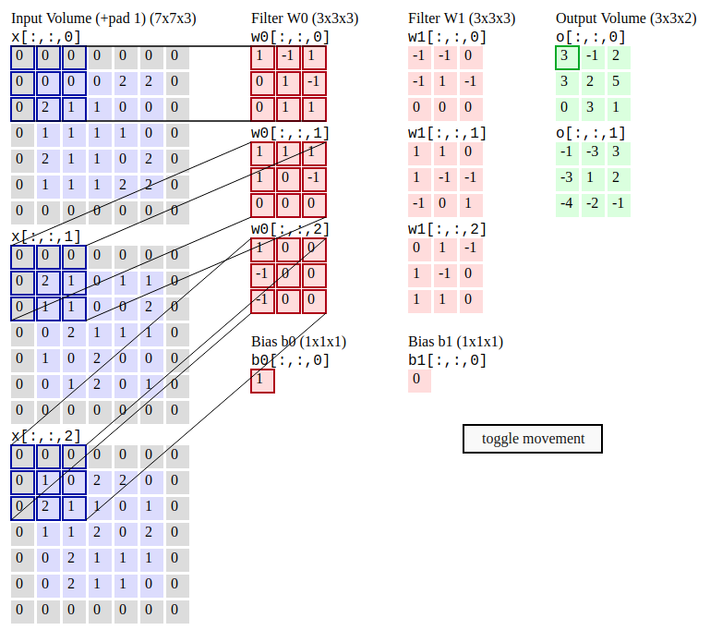
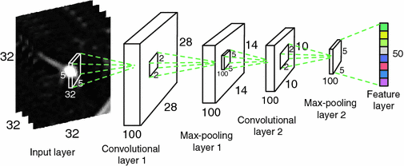
Convolutional Neural Network
A simple Convolutional Network is a sequence of layers: Convolutional Layer, Pooling Layer, Fully-Connected Layer
for example -
[INPUT - CONV - RELU - POOL - FC]
Convolution Layer -
Takes input with dimension [wxhxd]
Requires number of filters, F (e.g. [3x3x3 ])
Define stride, S and other hyperparameters
Produce output volume [wxhxd] using F, S and other hyperparameters

Slide 9
Algorithm
i= all 50 rows from the input file
j= all 50 rows from the input file except i
for i = first input volume
for j = second input volume
Z1 = z vector for i
Z2 = z vector for j
for t = 0 to 1
new_z = (1-t) x Z1 + t x Z2
run decoder network
t = t + 0.1
Z1 = [2 x 2 x 2 x 8] = 64
Z2 = [2 x 2 x 2 x 8] = 64

Slide 10
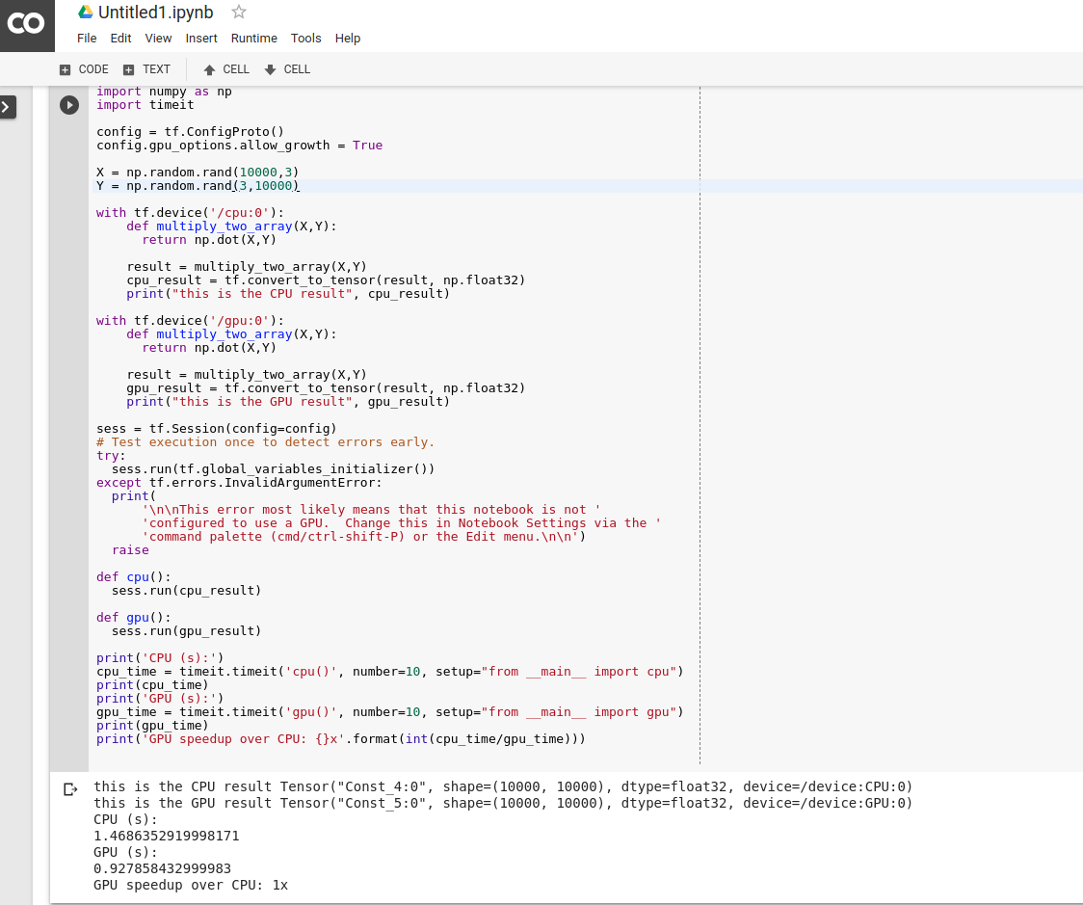
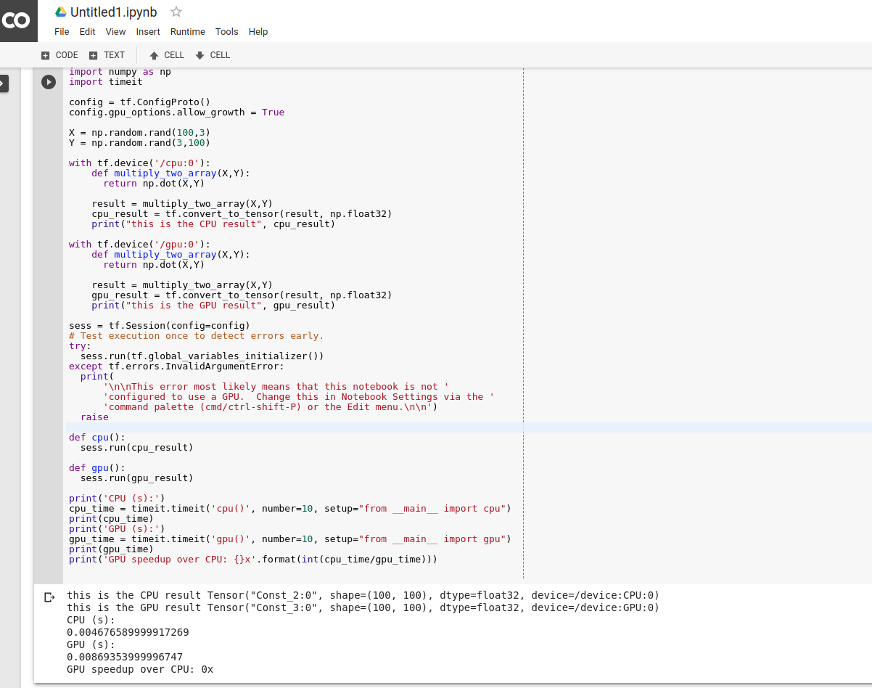
Why parallelism
Cilk
OpenCl
MPI
CUDA
GPU utilization for heavy computation of data
Increase performance (linear speedup)
Parallel Languages

Slide 11
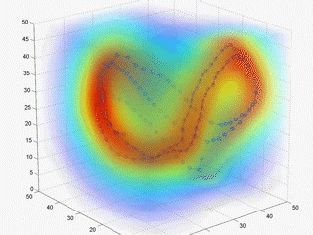
Why Parallelization inside Z vector
Lower dimension but maximum features
Can be reshape easily
Linearly grows with input data
Involve significant amount of time while comparing with different combination of dataset

Slide 12
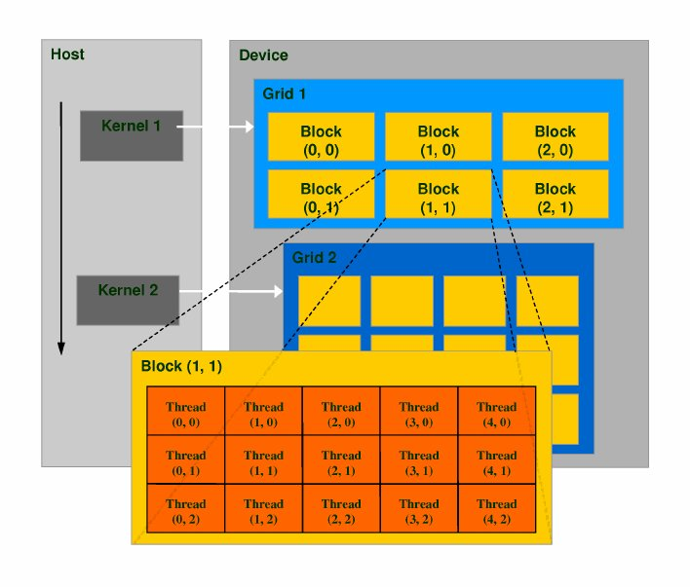
CUDA Parallel Programming Framework
Host
Device
Kernel
Threads
Block
Grid
CUDA supported languages
C
C++
fortran
Python

Slide 13
CUDA programming (Introduction to Numba)
import numpy as np
from timeit import default_timer as timer
from numba import vectorize
@vectorize(["float32(float32,float32)"], target='cuda')
def vectorAdd(a,b):
return a + b
def main():
N = 3200000
A = np.ones(N, dtype = np.float32)
B = np.ones(N, dtype = np.float32)
C = np.zeros(N, dtype = np.float32)
start = timer()
C = vectorAdd(A,B)
vectoradd_time = timer() - start
print("C[:5] = " + str(C[:5]))
print("C[-5:] = " + str(C[-5:]))
print("Vector Add took %f seconds:" , vectoradd_time)
if __name__ == "__main__":
main()
Python decorators
Numba supports CUDA GPU programming
Compiles Python code into CUDA kernels and device functions following the CUDA execution model.
Numba makes it appear that the kernel has direct access to NumPy arrays

Slide 14
Numba Kernels
Kernel Declaration
from numba import cuda @cuda.jit def my_kernel(io_array): """ Code for kernel. """ # code here
Kernel Invocation
import numpy ​ # Create the data array - usually initialized some other way data = numpy.ones(256) # Set the number of threads in a block threadsperblock = 32 # Calculate the number of thread blocks in the grid blockspergrid = (data.size + (threadsperblock - 1)) // threadsperblock # Now start the kernel my_kernel[blockspergrid, threadsperblock](data) # Print the result print(data)

Slide 15


Project Implementation
Grid 1
Dataset -- > 50 shapes of chair (each with dimension [32 x 32 x 32 ])
Epoch = 5
Z vector = [2x2x2x8] -> reshape into [8, 8]
Thread = [4 , 4]
Blocks = [2, 2]
block 1
block 2
threads
TPB = 4
l_space1 = np.reshape(l_space1,(8,8))
l_space2 = np.reshape(l_space2,(8,8))
print("lspace 1", l_space1)
print("lspace 2", l_space2)
dA = cuda.to_device(l_space1)
dB = cuda.to_device(l_space2)
c = np.empty_like(l_space2)
dC = cuda.to_device(c)
start = timer()
threadsperblock = (TPB, TPB)
blockspergrid_x = int(math.ceil(l_space1.shape[0] / threadsperblock[0]))
blockspergrid_y = int(math.ceil(l_space2.shape[1] / threadsperblock[1]))
blockspergrid = (blockspergrid_x, blockspergrid_y)
for t in range(0, 100):
interpolationBetnLatentSpace[blockspergrid, threadsperblock](dA, dB, dC, t)
block 3
block 4
Implemented CUDA architecture for the project

Slide 16
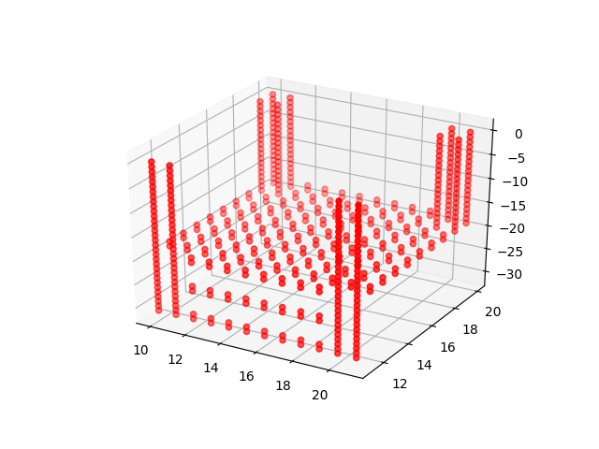
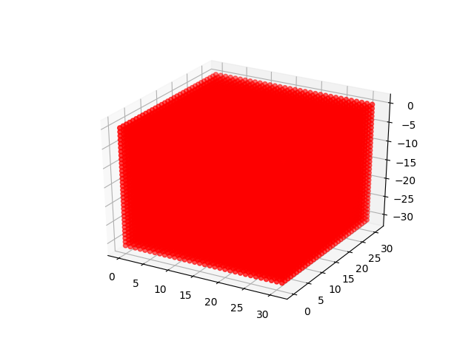
Threads Index Calculation
Results
@numba.cuda.jit
def interpolationBetnLatentSpace(A,B,C,t):
tx = cuda.threadIdx.x
ty = cuda.threadIdx.y
bx = cuda.blockIdx.x
by = cuda.blockIdx.y
bw = cuda.blockDim.x
bh = cuda.blockDim.y
row = tx + bx * bw
col = ty + by * bh
if row < C.shape[0] and col < C.shape[1]:
for k in range(A.shape[1]):
tmp = (1-t) * A[row, k] + t * B[row, k]
C[row, k] = tmp
@numba.cuda.jit
def interpolationBetnLatentSpace(A,B,C,t):
sA = cuda.shared.array(shape=(8, 8), dtype=float32)
sB = cuda.shared.array(shape=(8, 8), dtype=float32)
x, y = cuda.grid(2)
tx = cuda.threadIdx.x
ty = cuda.threadIdx.y
if x < C.shape[0] and y < C.shape[1]:
tmp = 0
for i in range(int(A.shape[1] / TPB)):
# Preload data into shared memory
sA[tx, ty] = A[x, ty + i * TPB]
sB[tx, ty] = B[tx + i * TPB, y]
cuda.syncthreads()
for k in range(8):
tmp = (1-t) * A[tx, k] + t * B[tx, k]
cuda.syncthreads()
C[tx, k] = tmp
Output volume after interpolation
Global memory
Shared memory

Slide 17
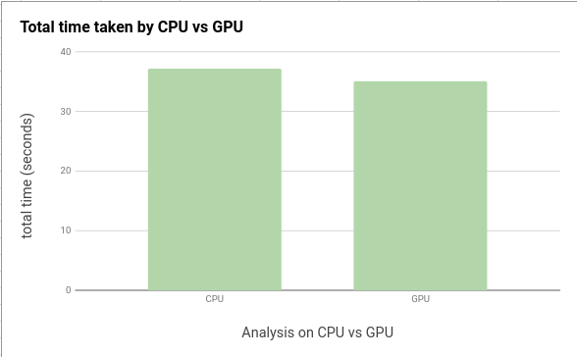
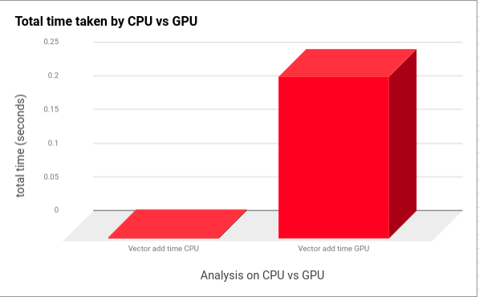
CPU vs GPU analysis
For 5 epochs :
Total time CPU = 37.15s
Vector Add time CPU = 0.0017s
Time taken by CNN layers = 11s
Total time GPU = 35.04s
Vector Add time GPU (global memory) = 0.24s
Vector Add time GPU (shared memory) = 0.17s
Time taken by CNN layers = 11s
GPU speedup over CPU = 37.15 / 35.04 seconds = 1.06 seconds

Slide 18
Limitation
1. For one pair comparison of volumes, CPU performs better than GPU
2. Very low dimension of Z could effect GPU performance
3. Running threads in shared memory of GPU is taking 1.5x more than global memory
Challenges
1. As a dynamic type system, explicit memory allocation in Python is not possible
2. Less example and documentation of Python-CUDA compared to CUDA-C or CUDA-C++
3. Inside Kernel function, debugging is not available

Slide 19

Questions
1. What is Linear Interpolation ?
2. How does Numba work ?
3. Considering the results, does increasing the dimension of Z vectors or volumes of input shape would increase the GPU performance ?

